Slide 1
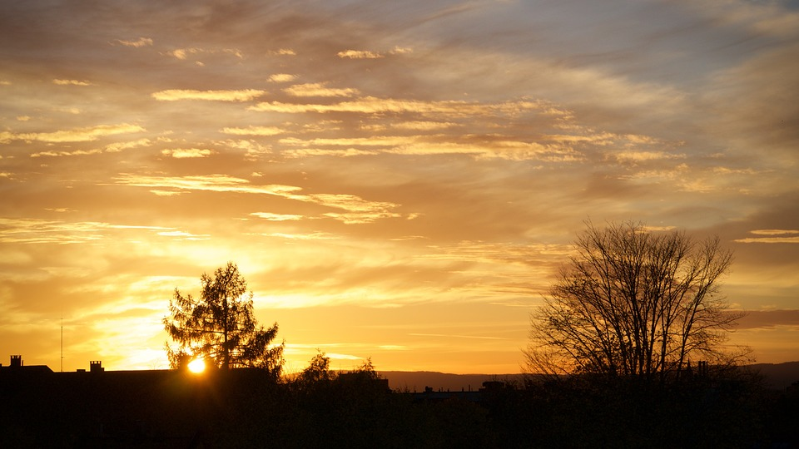
“ I AM ”
“Therefore I said to you that you will die in your sins; for if you do not believe that I am He, you will die in your sins.” (John 8:24)
Notes:
Wonderful “I AM” statements of Jesus in scripture:
John 8:24, in speaking to unbelieving Jews…

Slide 2
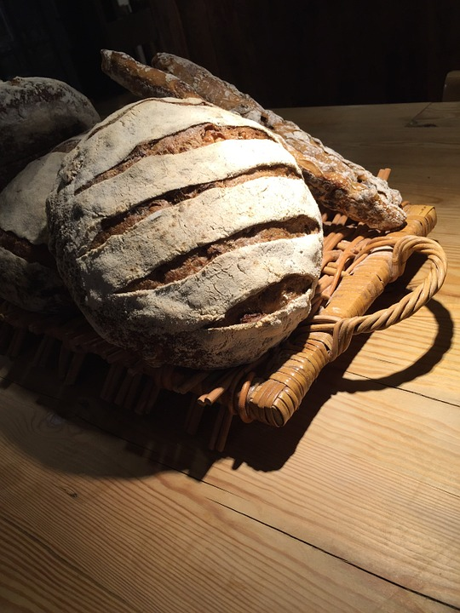
I am the bread of life
John 6:35 (6:47-48; 27,63)
Notes:
I am the bread of life (Jno. 6:35, 48).
(35), “And Jesus said to them, " I am the bread of life. He who comes to Me shall never hunger, and he who believes in Me shall never thirst.”
(47-48), “Most assuredly, I say to you, he who believes in Me has everlasting life. 48 I am the bread of life.
Jesus gives the food that sustains eternal life. That food is His words (Jno. 6:27, 63).
(27), “Do not labor for the food which perishes, but for the food which endures to everlasting life, which the Son of Man will give you, because God the Father has set His seal on Him.“
(63), “It is the Spirit who gives life; the flesh profits nothing. The words that I speak to you are spirit, and they are life.

Slide 3
I am the light of the world
John 8:12; 9:5
Notes:
I am the light of the world (Jno. 8:12; 9:5)
(8:12), “Then Jesus spoke to them again, saying, " I am the light of the world. He who follows Me shall not walk in darkness, but have the light of life.“
(9:5), “As long as I am in the world, I am the light of the world.“
Jesus illuminates the sinner’s walk in this dark world of sin.

Slide 4
I am the door
John 10:7, 9
Notes:
I am the door (Jno. 10:7, 9).
(10:7), “Then Jesus said to them again, " Most assuredly, I say to you, I am the door of the sheep.”
(10:9), “I am the door. If anyone enters by Me, he will be saved, and will go in and out and find pasture.”
Jesus is our access to spiritual salvation and safety

Slide 5
I am the good shepherd
John 10:11, 14
Notes:
I am the good shepherd (Jno. 10:11, 14).
(11), “I am the good shepherd. The good shepherd gives His life for the sheep.”
(14), “I am the good shepherd; and I know My sheep, and am known by My own.”
Jesus guards and leads His sheep

Slide 6
I am the resurrection and the life
John 11:25
Notes:
I am the resurrection and the life (Jno. 11:25).
(24-26), “Martha said to Him, "I know that he will rise again in the resurrection at the last day."25 Jesus said to her, " I am the resurrection and the life. He who believes in Me, though he may die, he shall live. 26 And whoever lives and believes in Me shall never die. Do you believe this?"
Jesus is the source of eternal life.

Slide 7
I am the way, the truth, and the life
John 14:6
Notes:
I am the way, the truth and the life (Jno. 14:6).
(5-6), “Thomas said to Him, "Lord, we do not know where You are going, and how can we know the way?"6 Jesus said to him, " I am the way, the truth, and the life. No one comes to the Father except through Me.”
Jesus is the only way to come to the Father.

Slide 8
I am the true vine
John 15:1
Notes:
I am the true vine (Jno. 15:1).
(1-4), "I am the true vine, and My Father is the vinedresser. 2 Every branch in Me that does not bear fruit He takes away; and every branch that bears fruit He prunes, that it may bear more fruit. 3 You are already clean because of the word which I have spoken to you. 4 Abide in Me, and I in you. As the branch cannot bear fruit of itself, unless it abides in the vine, neither can you, unless you abide in Me.”
Jesus is the source of life to all His disciples.

Slide 9
“ I AM ”
“Therefore I said to you that you will die in your sins; for if you do not believe that I am He, you will die in your sins.” (John 8:24)
Notes:
The book penned by the apostle John presents sufficient evidence for men to believe that Jesus of Nazareth is the Christ, the Son of God.
Eternal life is the aim of such faith
(John 20:30-31), “And truly Jesus did many other signs in the presence of His disciples, which are not written in this book; 31 but these are written that you may believe that Jesus is the Christ, the Son of God, and that believing you may have life in His name.

